Slide 1
External Storage

Slide 2
External Storage
Overview
Magnetic Disk
  RAID
  Removable
Optical
  CD-ROM
  CD-Writable (WORM)
  CD-R/W
  DVD
Magnetic Tape

Slide 3
Magnetic Disks
Organization
Disk is constructed using magnetizable material (iron oxide - rust)
Magnetic patterns are recorded onto the surface and read back
A disk head reads and writes data onto the disk
  Reads/writes blocks of data
Range of packaging
  Floppy
  Winchester hard disk
  Removable hard disk

Slide 4
Magnetic Disks
Organization
Concentric rings or tracks
  Gaps between tracks
  Reduce gap to increase capacity
  Same number of bits per track (variable packing density)
  Constant angular velocity (rotation speed)
Tracks divided into sectors
Minimum block size is one sector
May have more than one sector per block

Slide 5
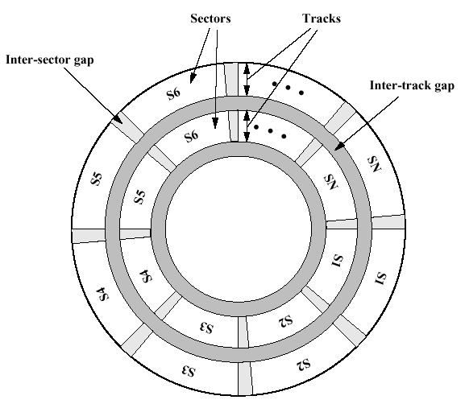
Magnetic Disks
Organization

Slide 6
Magnetic Disks
Characteristics
Fixed (rare) or movable head
Removable or fixed
Single or double (usually) sided
Single or multiple platter
Head mechanism
  Contact (Floppy)
  Fixed gap
  Flying (Winchester)

Slide 7
Magnetic Disks
Characteristics
Fixed head
  One read write head per track
  Heads mounted on fixed ridged arm
Movable head
  One read write head per side
  Mounted on a movable arm
Removable disk
  Can be removed from drive and replaced with another disk
  Provides unlimited storage capacity
  Easy data transfer between systems
Nonremovable disk
  Permanently mounted in the drive

Slide 8
Magnetic Disks
Characteristics
Double sided
  One R/W head per side
  Heads are joined and aligned
    Move together
  Aligned tracks on each platter form cylinders
  Data is striped by cylinder
    Reduces head movement
    Increases transfer rate

Slide 9
Magnetic Disks
Characteristics
Format
  Identifies start of tracks and sectors
  Stores additional information to mark tracks and sectors
Gap1
Id
Gap2
Data
Gap3
Gap1
Id
Gap2
Data
Gap3
Sync
byte
Track
Head
Sector
CRC
Sync
byte
Data
CRC

Slide 10
Magnetic Disks
Characteristics
Seek time
  Moving head to correct track
(Rotational) latency
  Waiting for data to rotate under head
  An average of one-half spin
Access time =
seek time + rotational latency
Transfer rate
  Peak amount of data transferred to/from disk
  Typically ~10 MBps

Slide 11
Magnetic Disks
Examples
Floppy
  5.25”, 3.5”
  Small capacity
    Up to 1.44Mbyte (2.88M never popular)
  Slow
  Universal
  Cheap
ZIP
  Cheap
  Very common
  Only 100M

Slide 12
Magnetic Disks
Examples
Winchester hard disk
  Sealed unit
  One or more platters (disks)
  Heads fly on layer of air as disk spins
    Very small head to disk gap
  Universal
  Cheap
  Fastest external storage
  Large data storage – several gigabytes
    72 GB currently available

Slide 13
RAID
Overview
Redundant Array of Independent/Inexpensive Disks
6 levels in common use
  Not a hierarchy
Set of physical disks viewed as single logical drive by O/S
Data distributed across physical drives
Can use redundant capacity to store parity information

Slide 14
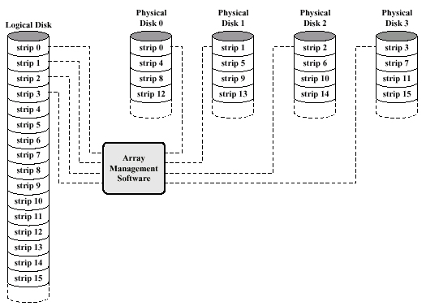
RAID
Overview

Slide 15
RAID
Level 0 (Striping)
No redundancy
Data striped across all disks
Round-robin striping
Increases speed
  Multiple data requests probably not on same disk
  Disks seek in parallel
  A set of data is likely to be striped across multiple disks
Good for high-performance access

Slide 16
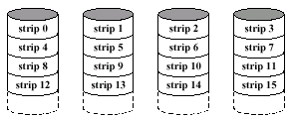
RAID
Level 0 (Striping)

Slide 17
RAID
Level 1 (Mirroring)
Mirrored Disks
Data is striped across disks
2 copies of each stripe on separate disks
Read from either
Write to both
Recovery is simple
  Swap faulty disk & re-mirror
  No down time
Expensive
Good for operating system disk

Slide 18
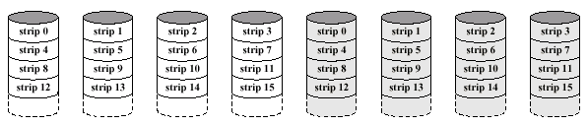
RAID
Level 1 (Mirroring)

Slide 19
RAID
Level 3
Very small strips
A single redundant disk
  Simple parity bit for each set of corresponding bits
Data on failed drive can be reconstructed from surviving data and parity info
Very high transfer rates but poor request rate
Good for video, CAD, and imaging systems
  Large, sequential reads

Slide 20
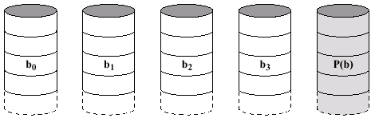
RAID
Level 3

Slide 21
RAID
Level 5
Each disk operates independently
  Good for high I/O request rate
Large stripes
Parity striped across all disks
  Round robin allocation for parity stripe
Good for network servers (file servers, e-mail, web, etc. )
Does not mean 5 disks

Slide 22
CD-ROM
Overview
Originally for audio
650 MB
  ~70 minutes audio
Polycarbonate coated with highly reflective coat, usually aluminum
Data stored as pits
  Read by reflecting laser
Constant packing density
  Constant linear velocity

Slide 23
CD-ROM
Overview
Audio is single speed
  Constant linier velocity
  1.2 ms⁻¹
  Track (spiral) is 5.27km long
  Gives 4391 seconds = 73.2 minutes
Other speeds are quoted as multiples
  E.g. 8x, 24x, 40x

Slide 24
CD-ROM
Overview
00
FF
x 10
00
Layered
ECC
Sec
Mode
Data
Min
Sector
12 byte
Sync
4 byte
Id
2048 byte
288 byte
2352 byte
Mode 0=blank data field
Mode 1=2048 byte data+error correction
Mode 2=2336 byte data

Slide 25
CD-ROM
Overview
Random-access is difficult due to variable speed
  Move head to rough position
  Set correct speed
  Read address
  Adjust to required location
Slow
Read only
Easy to mass produce
  Expensive for small runs
Removable
Robust

Slide 26
CD-ROM
Writable CDs
CD-Writable
  WORM
  Now affordable
  Compatible with CD-ROM drives
CD-RW
  Erasable
  Getting cheaper
  Mostly CD-ROM drive compatible

Slide 27
DVD
Overview
Digital Video Disk
  Used to indicate a player for movies
  Only plays video disks
Digital Versatile Disk
  Used to indicate a computer drive
  Will read computer disks and play video disks
DVD drives cannot automatically decode and play movies

Slide 28
DVD
Overview
Multi-layer
Very high capacity (4.7G per layer)
Full length movie on single disk
  Using MPEG compression
Standardized
Movies carry regional coding
  Players only play correct region films

Slide 29
Magnetic Tapes
Overview
Serial access
Slow
Very cheap
Mainly backup and archive
Digital Audio Tape (DAT)
  Uses rotating head (like video)
  High capacity on small tape
    4Gbyte uncompressed
    8Gbyte compressed
  Backup of PC/network servers

Slide 30
Input/Output
Overview
Need to bring data into the system and save results
Device types
  Human readable
    Screen, printer, keyboard
  Machine readable
    Disks, tapes, sensors
  Communication (remote device)
    Modem, Network Interface Card (NIC)

Slide 31
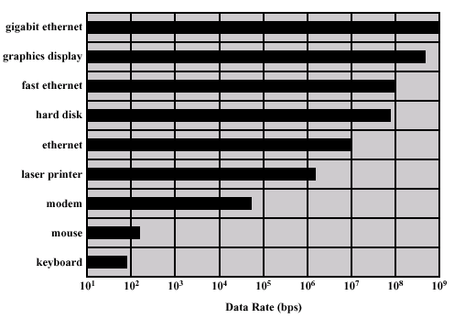
Input/Output
Overview

Slide 32
Input/Output
Overview
Wide variety of peripherals
  Deliver different amounts of data
  At different speeds
  In different formats
All slower than CPU and RAM
Need I/O modules to connect peripherals to the system bus

Slide 33
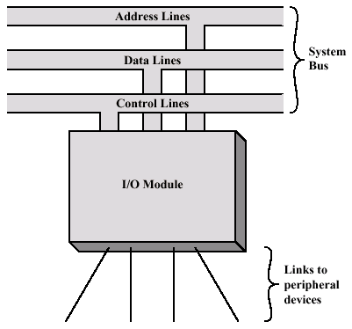
Input/Output
I/O Module

Slide 34
Input/Output
I/O Module Function
Control & timing
  Coordinate traffic flow between internal and external devices
CPU communication
  Process CPU requests
Device communication
  Read/write data to device
Data buffering
Error detection

Slide 35
Input/Output
Example Operation
CPU checks I/O module device status
I/O module returns status
If ready, CPU requests data transfer
I/O module gets data from device
I/O module transfers data to CPU
Variations for output, DMA, etc.

Slide 36
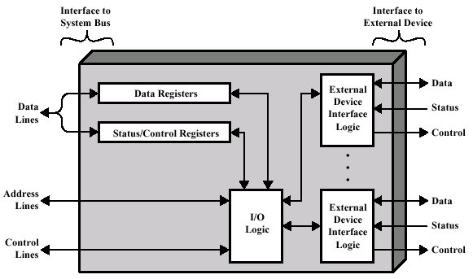
Input/Output
I/O Module

Slide 37
Input/Output
I/O Module
Support multiple or single device
Hide or reveal device properties to CPU
  Control device functions or leave for CPU
I/O Techniques
  Programmed I/O
  Interrupt driven I/O
  Direct Memory Access (DMA)

Slide 38
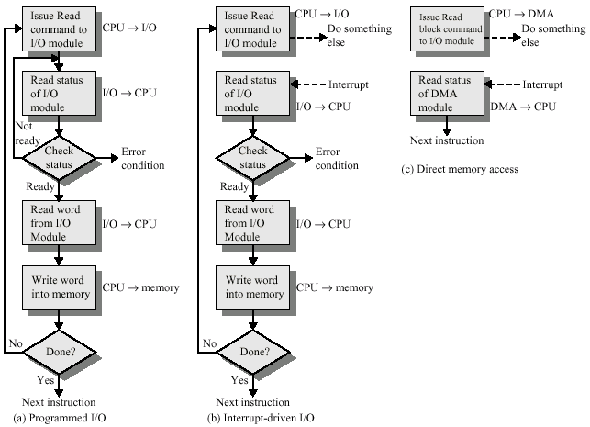
Input/Output
I/O Module

Slide 39
Input/Output
Programmed I/O
CPU has direct control over I/O
  Sensing status
  Read/write commands
  Transferring data
CPU waits for I/O module to complete operation
Wastes CPU time

Slide 40
Input/Output
Programmed I/O
CPU issues address
  Identifies module and device
  Similar to accessing memory from CPU viewpoint
CPU issues command
  Control - telling module what to do
    E.g. Spin up disk
  Test - check status
    E.g. Power? Error? Done?
  Read/Write
    Module transfers data via buffer from/to device

Slide 41
Input/Output
Programmed I/O
CPU requests I/O operation
I/O module performs operation
I/O module sets status bits
CPU checks status bits periodically
I/O module does not inform CPU directly
I/O module does not interrupt CPU
CPU may wait or come back later

Slide 42
Input/Output
I/O Mapping
CPU accesses I/O one of two ways:
Isolated I/O
  Separate address spaces for I/O devices
  Need I/O or memory select lines
  Special commands for I/O
Memory mapped I/O
  Devices and memory share an address space
  I/O looks just like memory read/write
  No special commands for I/O

Slide 43
Input/Output
Interrupt Driven I/O
Overcomes CPU waiting
CPU does not repeatedly check device for a completion
I/O module interrupts when ready
  Done or error

Slide 44
Input/Output
Interrupt Driven I/O
CPU issues read command
I/O module gets data from peripheral
  CPU does other work
I/O module interrupts CPU
CPU requests data
I/O module transfers data

Slide 45
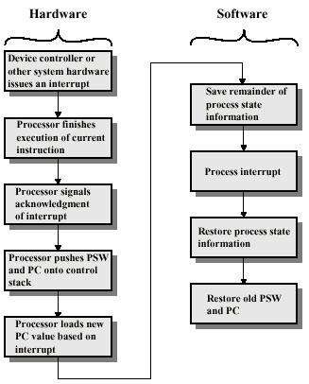
Input/Output
Interrupt Driven I/O
Check for interrupts after instruction
Save Program Status Word (PSW) – current processor state
Return to regular scheduled program

Slide 46
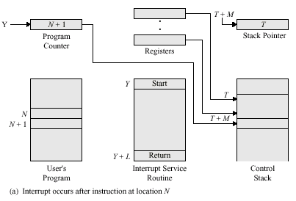
Input/Output
Interrupt Driven I/O

Slide 47
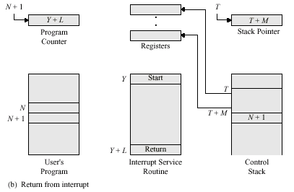
Input/Output
Interrupt Driven I/O

Slide 48
Input/Output
Interrupt Driven I/O
When an interrupt occurs, need to identify device causing interrupt
Multiple interrupt lines
  Limits number of devices
Software poll
  CPU asks devices in turn
  Slow

Slide 49
Input/Output
Interrupt Driven I/O
Hardware poll – daisy chain, vectored
  Interrupt acknowledge sent down a chain
  Module responsible places vector on bus
  CPU uses vector to identify handler routine
Bus arbitration – vectored
  Module must claim the bus before it can raise interrupt
  E.g. PCI & SCSI

Slide 50
Input/Output
Interrupt Driven I/O
Multiple devices can interrupt at the same time
Each interrupt line has a priority
Higher priority lines can interrupt lower priority lines
If bus mastering only current master can interrupt

Slide 51
Input/Output
DMA
Interrupt driven and programmed I/O require active CPU intervention
  Transfer rate is limited
  CPU is tied up
DMA removes CPU involvement
Additional hardware required on bus
  DMA controller
DMA controller takes over from CPU for I/O

Slide 52
Input/Output
DMA
CPU tells DMA controller
  Read/Write
  Device address
  Starting address of memory block for data
  Amount of data to be transferred
CPU carries on with other work
DMA controller completes transfer
DMA controller interrupts CPU when finished

Slide 53
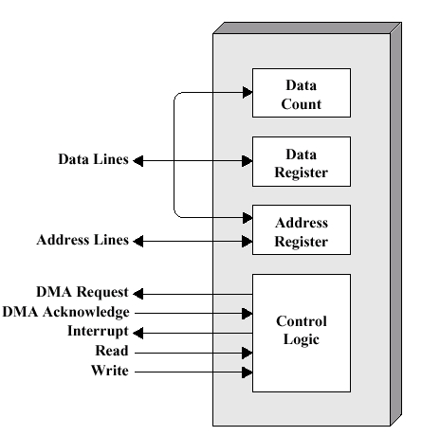
Input/Output
DMA

Slide 54
Input/Output
DMA
Cycle Stealing
  DMA controller takes over system bus for one cycle
  Transfers one word of data
  Not an interrupt
    CPU does not switch context
  CPU suspended just before it accesses bus
    I.e. before an operand or data fetch or a data write
  Slows down CPU but not as much as CPU doing transfer
  If data is cached, CPU is not stalled

Slide 55
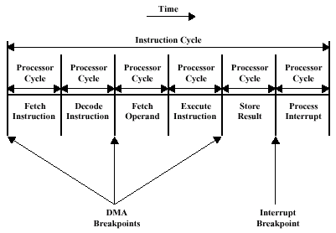
Input/Output
DMA

Slide 56
Input/Output
I/O Channels
Future of I/O interconnects
I/O devices are more sophisticated and intelligent
  E.g. 3D graphics cards
CPU instructs I/O controller to do transfer
I/O controller does entire transfer
  Takes load off CPU
  Dedicated processor is faster

Slide 57
SCSI
Overview
Small Computer System Interface
Interface for external peripheral devices
  Disk drives, CD-ROM, tape devices
Parallel interface
8, 16, or 32 bit data lines
5, 10 (fast), 20 (ultra), 40 (ultra-2) MHz
Daisy chained “bus”
Devices are independent
  Can communicate with each other as well as controller

Slide 58
SCSI
Overview
SCSI-1
  Early 1980s
  8 bit
  5 MHz
  Data rate 5 MBps
  Eight devices
    Controller + 7 others
SCSI-2 (Fast)
  1991
  16 and 32 bit
  10MHz
  Data rate 20 or 40 Mbytes
SCSI-3 (Ultra)
  Up to 80 MBps
SCSI-4 (Ultra-2)
  Up to 160 MBps

Slide 59
SCSI
Operation
Between initiator and target
  Usually controller & device (e.g. disk)
Activity on the bus occurs in a sequence of phases
  Bus free
  Arbitration
    Take control of bus
  Selection of target

Slide 60
SCSI
Operation
Phases continued
  Reselection by target to initiator
    Allows reconnection after suspension to resume an operation
    E.g. if request takes time to execute, bus can be released
  Command
    Target requests command information from the initiator
  Data
    Target requests data in or out of the initiator
  Status request
  Message request
    E.g message complete

Slide 61
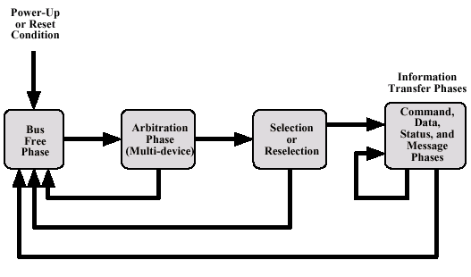
SCSI
Operation

